Slide 1
A PRESENTATION ON DETECTION OF SKIN CANCER ABNORMALITY BY IDENTIFICATION OF SKIN TEXTURE
By-
Group-M
Members:
Yuvaraja Panneerselvam (x17150663)
Yash Deorukhkar (x17165946)
Tejal Gavate (x17146895)
Sneha Vishwakarma (x17154251)

Slide 2
AIM AND OUTCOME
Aim:
To test a tumour for being malignant or benign in nature, based on abnormality, texture and colour of skin lesion
Approach:
Convolutional Neural Networks (CNN)
Outcome:
Type of skin cancer (malignant or benign)

Slide 3
INTRODUCTION
Most common and widely spread forms of cancer
The early detection can reduce the risks of it becoming fatal and precautions can be taken
A major problem as melanoma and non-melanoma, both cases are widely increasing
Studied using various approaches: clinical, biological, data mining

Slide 4
DATA MINING TECHNIQUE
Convolutional Neural Network (CNN)
Convolutional layers used-2
Feature maps in first convolution layer-32
Second convolution layer-64
Colour images are used
Hidden layers-2
Each layer with 128 neurons

Slide 5
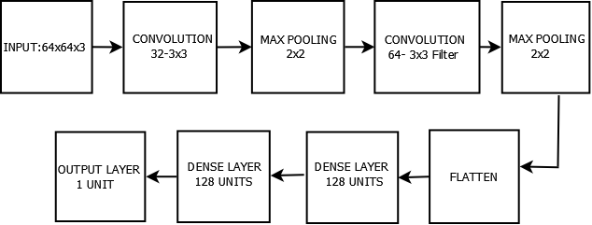

Slide 6
TECHNICAL DETAILS
Python 3.6 (jupyter notebooks for code development)
Backend: tensor flow
Keras package
CUDA 9.0, libraries were installed for running GPU

Slide 7
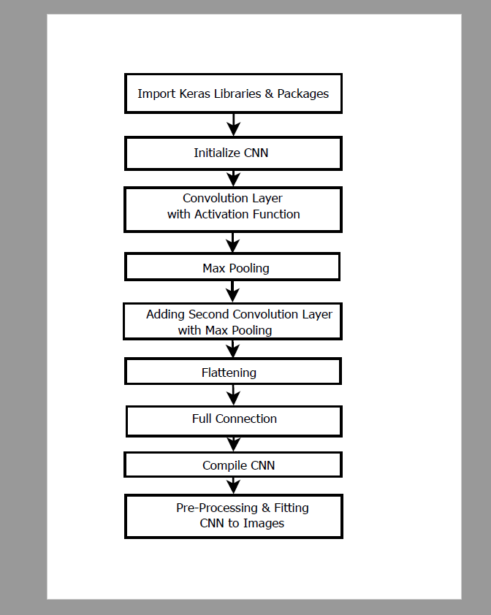
PROCESS FLOW

Slide 8
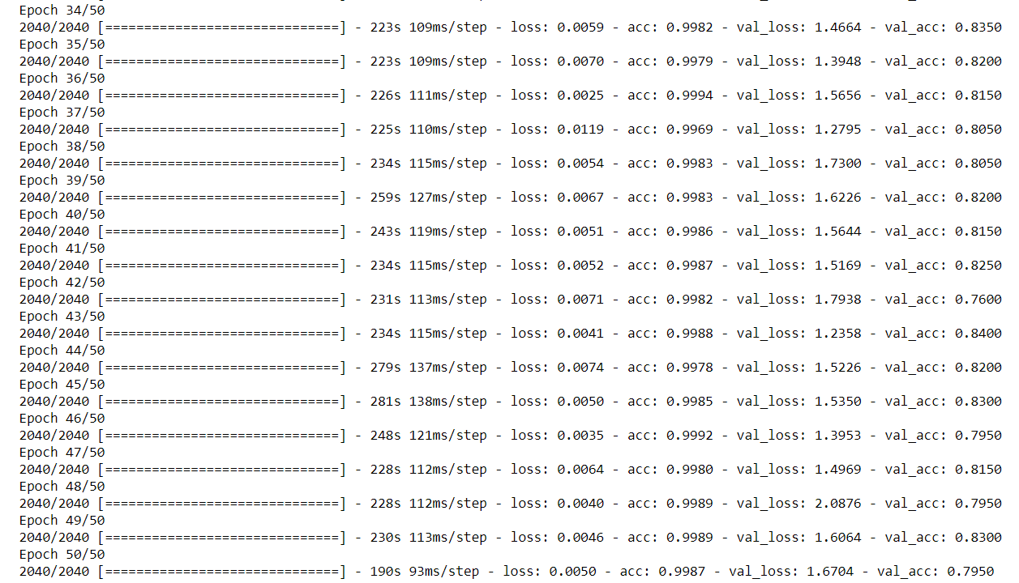
EVALUATION AND RESULTS
Results of evaluation and implications of design:
Training model accuracy is 98%.
Average Validation accuracy from testing set is 81.47%.
Average Validation loss of the testing dataset is 1.6%
Training loss is 0.006%.

Slide 9
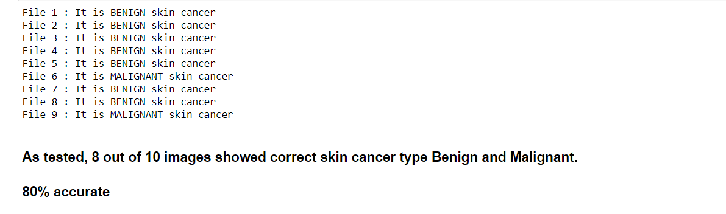
After that only 10 images were taken as an input in the keras predict function to compare the accuracy of classifier.
The results show that 8 out of 10 images were precisely classified i.e. the model is 80% accurate.
This shows that the chosen model is working accurately.

Slide 10
CONCLUSION
The validation accuracy of the testing dataset is 81.47%.
Hence, we can say that this model performs considerably well.
In future, the implemented model can work well for doctors to give an appropriate medical treatment of skin cancer to patients if a bigger dataset is considered.

